Slide 1
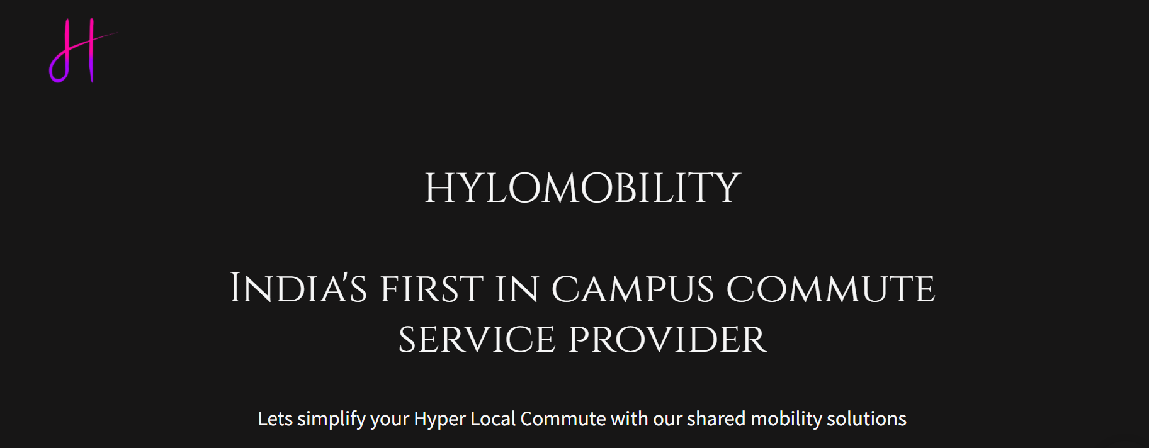

Slide 2
Addressing the need
Existing tech
Need of smart phone with internet connectivity and Hassle to log in via mobile app.
Poor software UI & upgrade.
Imported technologies with Limited software and hardware innovation.
Drawback
Lack of easy-to-access mobility solutions.
Inadequacy of time-saving commute.
Lack of data security and user need to share their personal data.

Slide 3
Introducing Hylomobility
Hylomobility brings you fleet subscription shared micro-mobility service, fulfilling your commute purposes and simplifying your hassle of in-campus mobility through E-MaaS (Electric Mobility as a Service) and smart card technology.
Equipped with advanced software and RFID technology. Our EV (hylomobility) can be your perfect partner to make your in-campus commute a seamless experience.
Affordability
Availability
Accessibility

Slide 4
Our Approach
Hylomobility
Smart card with shared mobility.
No requirement of smart phone and mobile app connectivity for operation.
Elegantly designed with advanced software & hardware fusion.
Opportunities
Easily accessible shared mobility solution for the user.
No worry about data privacy.
Making short distance commuting seamless.
Eco-friendly alternative for small distance travelling.

Slide 5
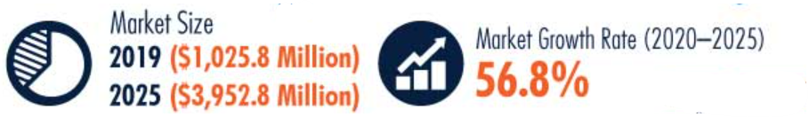
Shared Mobility (E-MaaS) Industry Overview
Cost effective and convenient mobility offered by shared mobility service providers is the prime factor supporting to the growth of the market.
Additional expenses, such as EV infrastructure, maintenance, insurance and parking, are taken care by the providers, which reduces the overall burden on Consumer.
Micro-mobility service is getting user interests in tire 2 and tire 3 cities, it has also received great support from public policies and structures to make its penetration even in towns.
The innovation, such as cloud sharing that delivers computing services related to network, software, storage, database, and analytics to users at low cost, is attracting new customer base, which in turn is benefitting the market in this category.
Business firms are increasingly tying-up with shared mobility service providers to offer transportation services to their employees, which in turn is boosting the market growth in this category.
South India generates the largest share in the Indian shared mobility market.

Slide 6
Seamless
Sustainable
Sharable
HyloMobility : Redefining Mobility
Fleet owners tie-up for quick accessibility
E-MaaS technology
Providing 150 vehicles per Fleet owner
RFID technology
Reduce traffic congestion & pollution
Smart-card facility
Technology fully designed and developed in India
Swappable batteries

Slide 7
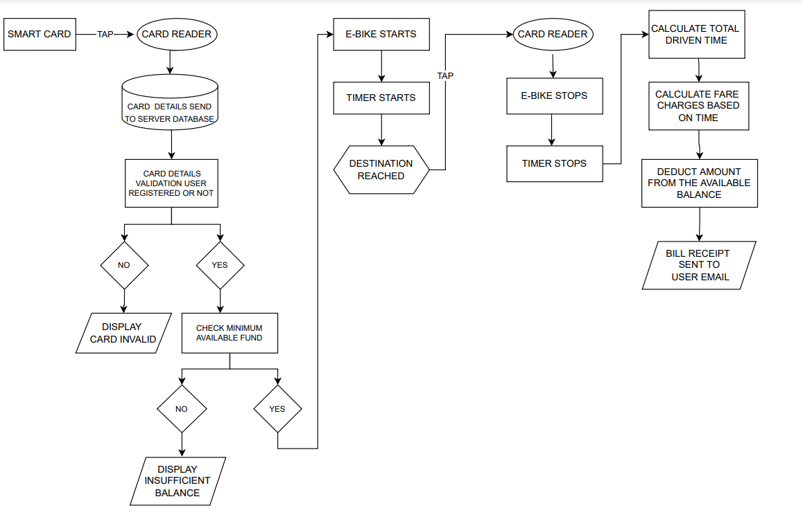
Product model workflow

Slide 8
Business model
Selling EVs to
fleet owners
HYLOMOBILITY
Subscription fee for IOT device from fleet owners
Selling Smart cards to fleet owners

Slide 9













Competitive Analysis
 | Yulu | Vogo | Smart Bike | Bounce Scooters | Hylomobility
Subscription model
Smart-card service
Swappable batteries
RFID technology
Intra-campus commute

Slide 10

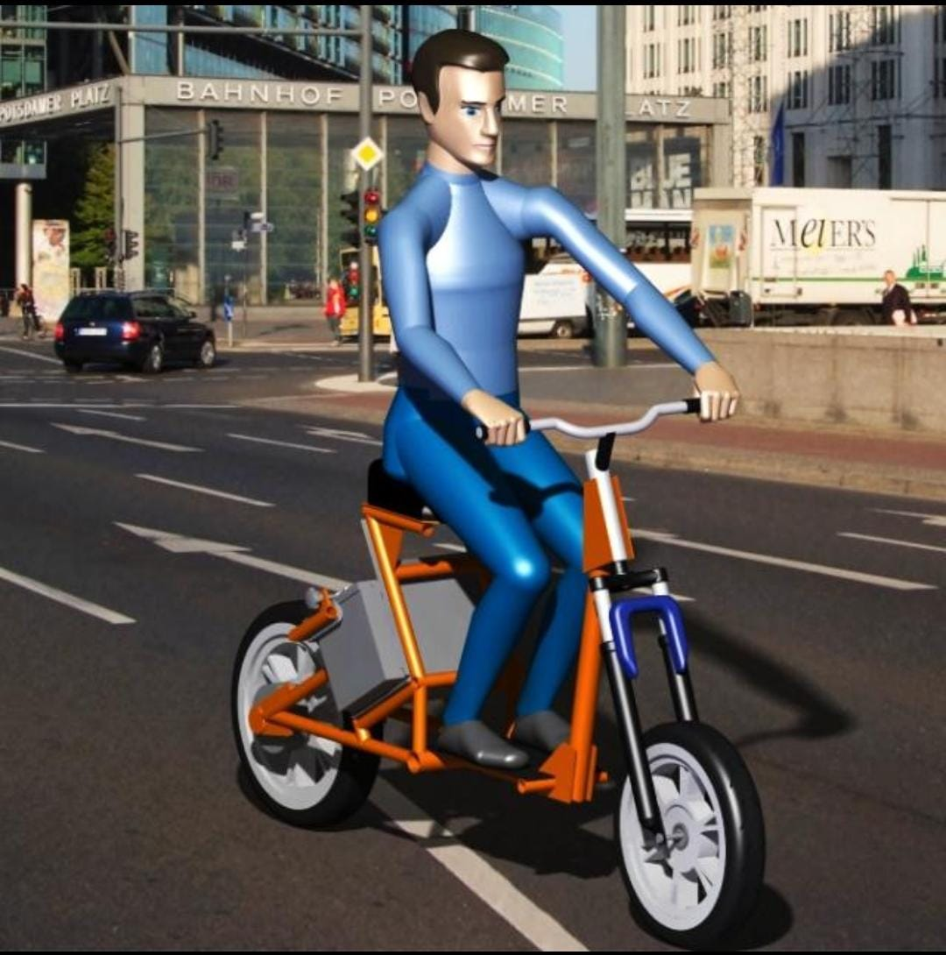
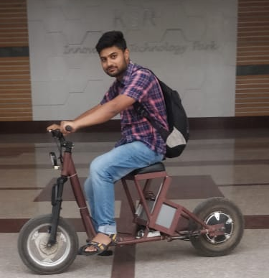
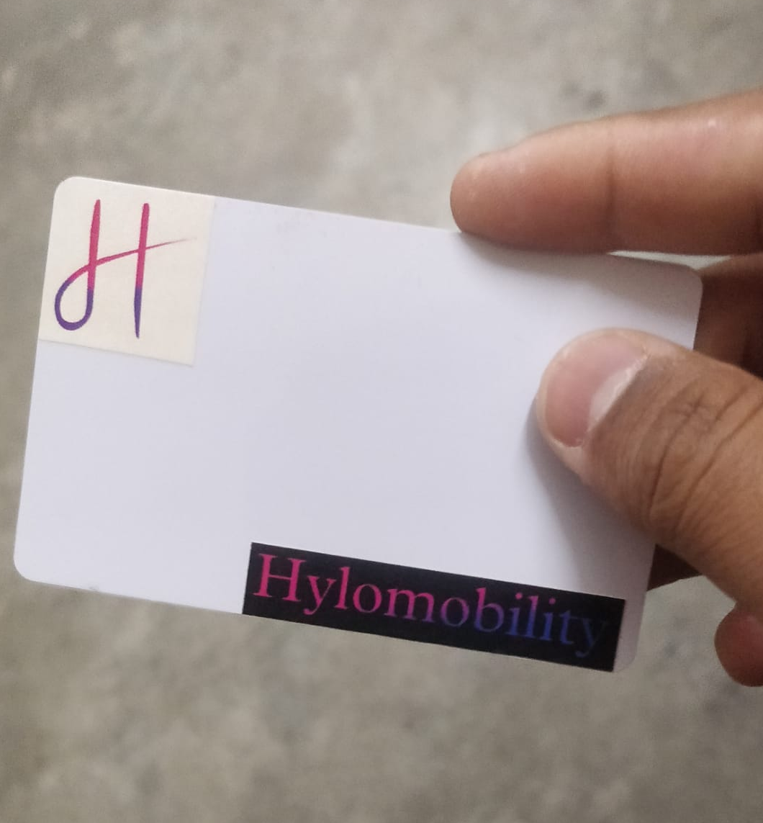
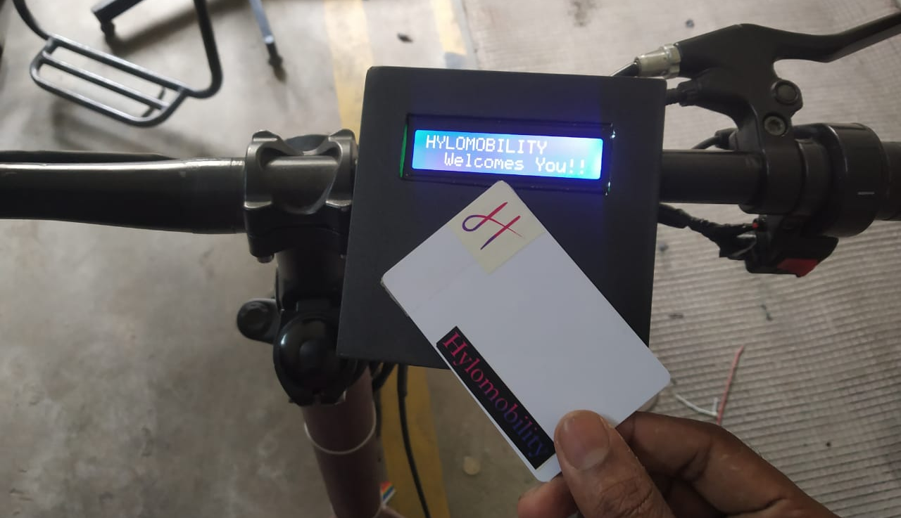
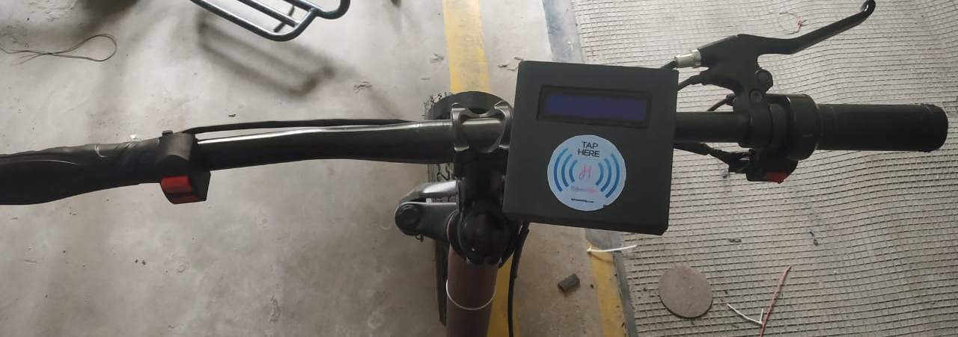
Basic Developed Prototype

Slide 11
Technical Details
EV Specification
Micro-Mobility vehicle
Designed for comfort of all age groups (unisex)
No need of license, insurance, helmet
No need of vehicle registration
Powered by 36v 250W Hub Motor
36v 18ah LFP battery pack
Swappable battery pack
Anti theft security.
Range : 55km per charge
Max speed : 25km/hr
Front & rear suspension for better comfort

Slide 12
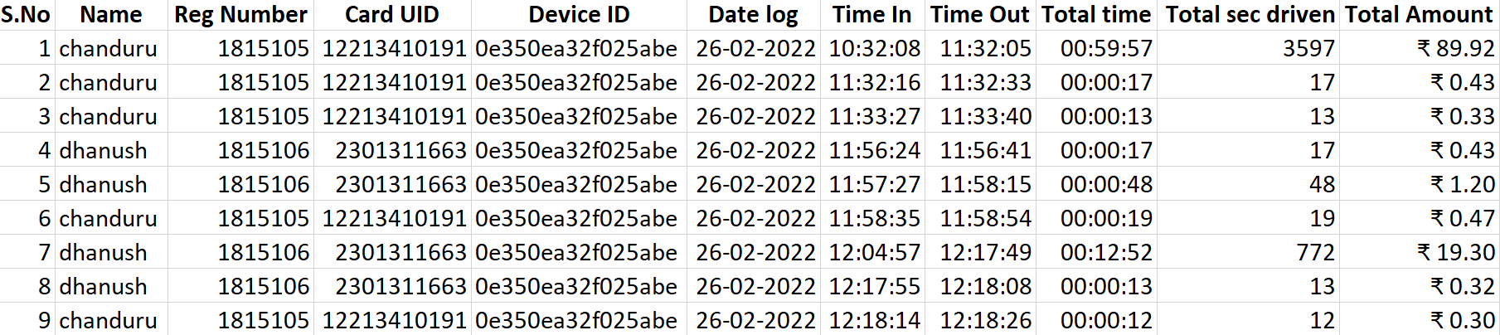
Experimental data With 2 users and 1 Electric bike
Name : User Name
Reg Number : User Unique Id
Card UID : Smart card Id
Device ID : Vehicle Unique Id

Slide 13
Financial Forecast
Gross profits in cr

Slide 14
Utilization of the 15 lakhs MSME grant

Slide 15
Roadmap
2027 - 2035
Phase 3
Getting into public shared mobility through NCMC (National Common Mobility Card) scheme
2023 - 2027
Phase 2
Current Phase
Expanding through states
Smart-scale expansion
2022 - 2023
Phase 1
Development of Product
Creating MVP

Slide 16
Advisors and Mentors
PRASANTHKUMAR PALANI
EX- Mercedes Benz R&D,
Automotive homologation expert,
Head of electric vehicle homologation team of Haritha techlogix,
Active member of EV expert group of ASDC, New Delhi
Corporate Trainer.
SAMPATH KUMAR
EX- Robert Bosch,
15+ years of experience in Embedded systems and IOT hardware technology,
Cloud Automation and Management.
Dr R GOPALAKRISHNAN
Principal - K S Rangasamy college of technology
Dr A KUMARAVEL
Dean – School of Mechanical Science
K S Rangasamy college of technology

